Slide 1
Machine Learning Application

Slide 2
Spam Email detection
Machine Learning
Spam
Email Text
Email metadata
Ham – Not Spam

Slide 3
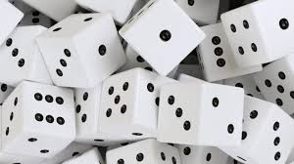
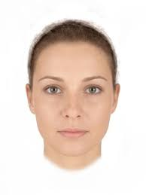
Facebook photo tagging
Not face
Machine Learning
face

Slide 4
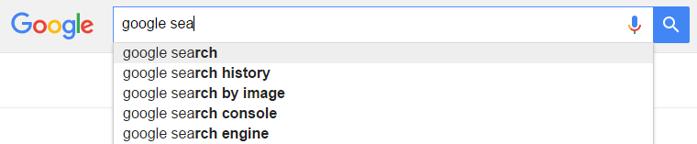
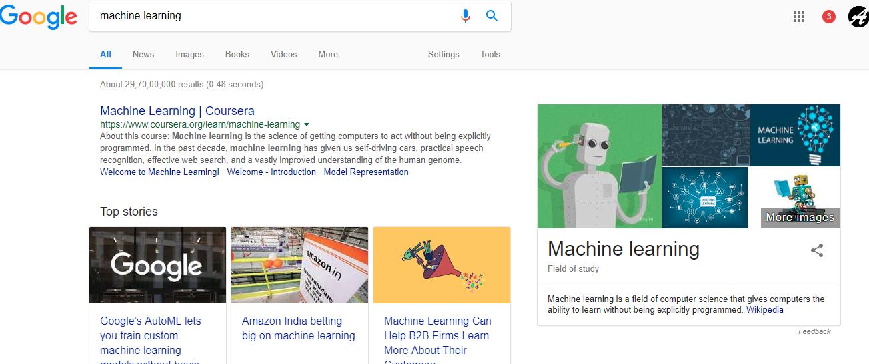
Google auto suggest and web search result

Slide 5

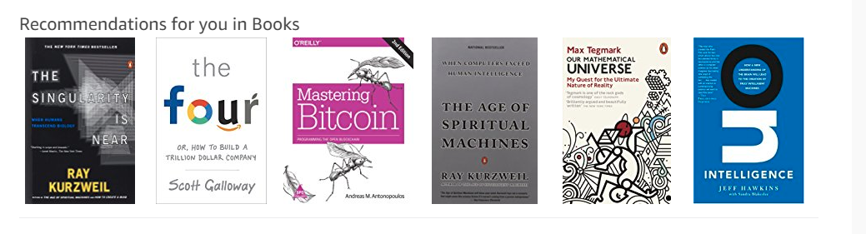
Product recommendation

Slide 6
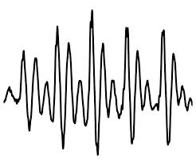
Speech recognition
Machine Learning
Hello Machine Learning

Slide 7
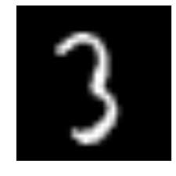
Digit Recognition
3
Machine Learning

Slide 8
Credit card fraud detection
Online advertising
Medical Diagonisis

